Slide 1

MCA Major Project Mid Term Evaluation
Resume Builder
Under the guidance of
Dr. Monika Jyotiyana
Department of Computer Applications
Faculty of Science, Technology and Architecture
Manipal University Jaipur
By
Divyanshu Singhal
23FS20MCA00072
2023-25

Slide 2
Outline
Introduction
Motivation
Process Model
Software Requirement Specification (SRS)
Data Flow Diagram (DFD)
Conclusion
Future Scope

Slide 3
INTRODUCTION
In today’s job market, having a good resume is really important. But making a professional resume can take a lot of time and effort. To make this easier, I built a Resume Builder application as part of my major project during my internship.
This tool helps students quickly create clean and professional resumes. It also includes an ATS (Applicant Tracking System) checker that shows how well a resume will perform when scanned by hiring software used by many companies.

Slide 4
MOTIVATION
The idea for this project came from the need to make resume building easier for students at the college level. Many students face challenges with formatting and organizing their resumes properly.
Supporting students in job preparation: Many students find it difficult to format and structure their resumes correctly. This platform helps them create professional resumes with guidance tailored to their needs.
ATS Score Checker: The platform includes an ATS (Applicant Tracking System) score feature that helps students see how well their resume is likely to perform when scanned by hiring software used by many companies.
Scalable SaaS model: The project is built to support multiple institutions, offering customization and easy deployment.
Learning and innovation: This project has allowed me to explore enterprise-level SaaS development, integrating Next.js, Node.js, MongoDB, authentication systems, and scalable architecture.

Slide 5
PROCESS MODEL
AGILE DEVELOPMENT
Why Agile?
Iterative Progress – Deliver incremental improvements with each sprint. Scalability – Adaptable for SaaS with continuous feature updates. User-Centric – Regular feedback loops ensure alignment with client needs.
Phases:
Phase 1: Core Resume Builder
Phase 2: AI-Powered Enhancements
Phase 3: Cover Letter & Job-Specific Customization
Phase 4: Custom Branding & White-Labeling
Phase 5: Continuous Feedback & Refinements

Slide 6
SOFTWARE REQUIREMENT SPECIFICATION
User Roles & Features
Functional Requirements
Users: Create, edit, and download resumes.
Enterprise Admins: Manage student accounts, track usage.
Super Admin: Manage multiple institutions, set up subscription plans.
Non-Functional Requirements
Scalability: Handles multiple colleges & users.
Security: Encrypted data, JWT authentication.
Performance: Fast resume generation.
Availability: Cloud hosting with 99.9% uptime.

Slide 7
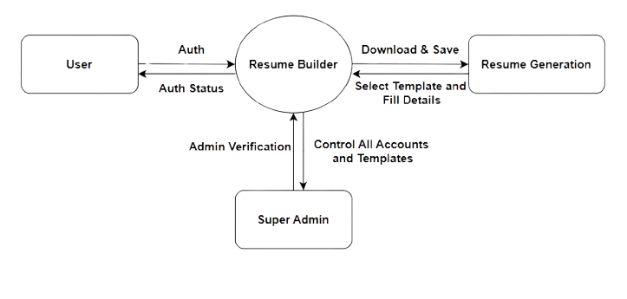
DATA FLOW DIAGRAM

Slide 8
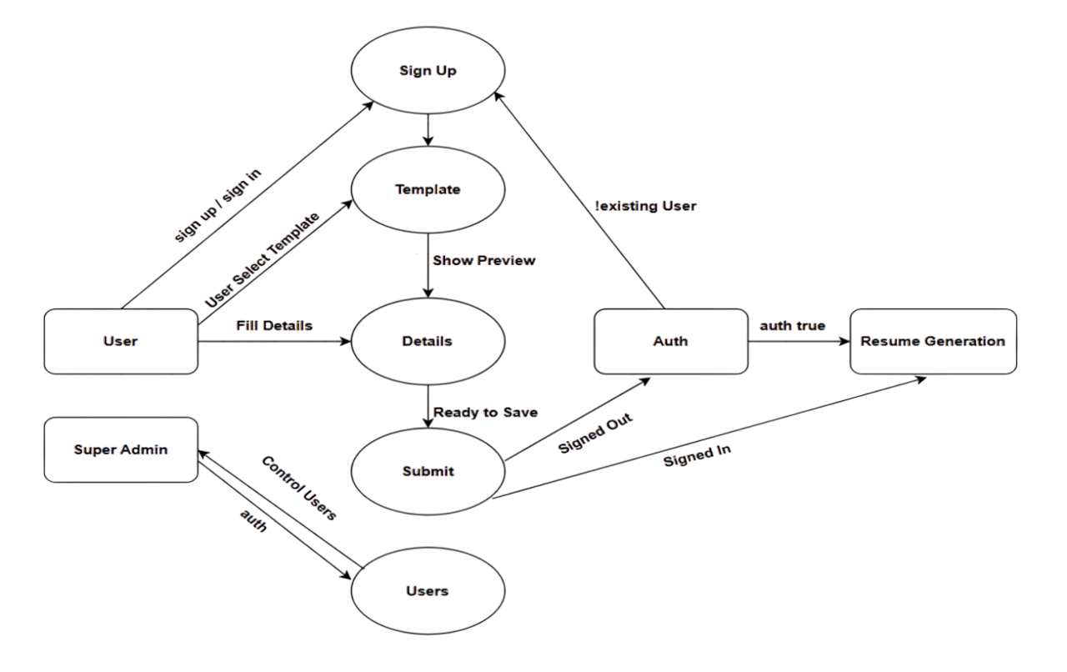
DATA FLOW DIAGRAM Level -0

Slide 9
CONCLUSION
Working on the Resume Builder project has been a great learning experience. It allowed me to apply my technical skills to solve a real problem that many students face creating a strong & professional resume. Through this project I explored modern web technologies built a user-friendly platform and added useful features like an ATS checker to improve resume quality. Overall, this project not only helped me grow as a developer but also gave me the chance to build something meaningful that can actually help students in their job search journey.

Slide 10
FUTURE SCOPE
LinkedIn Integration
Multi-Language Support

